Slide 1

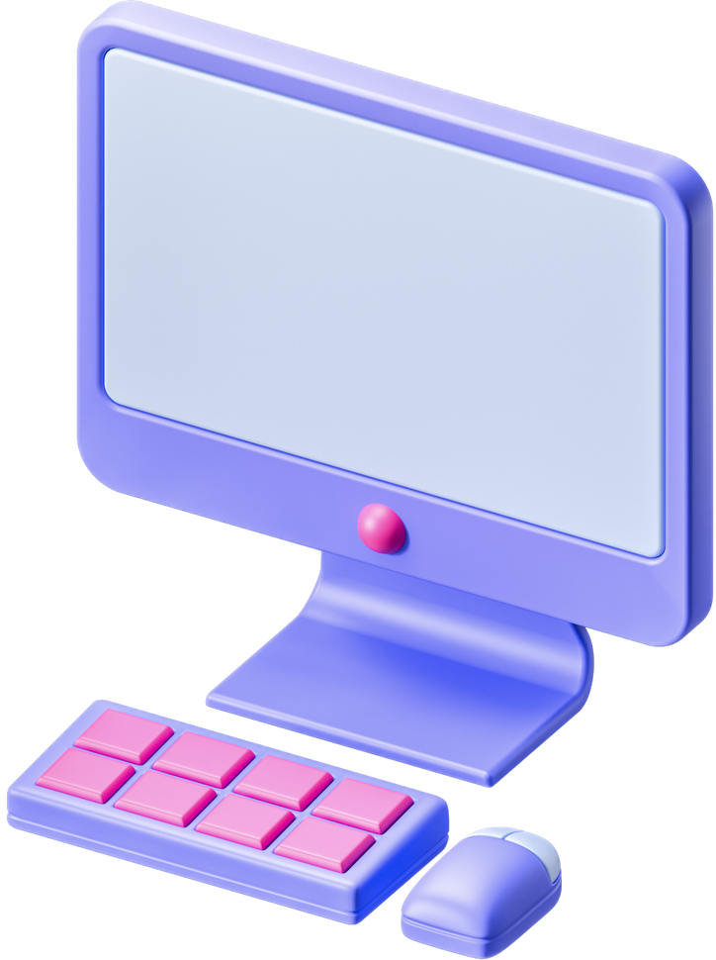



studio shodwe
DIGITAL EVOLUTION
COMPUTER
www.reallygreatsite.com

Slide 2


studio shodwe
MECHANICAL CALCULATORS
Early computing devices, like the abacus and slide rule, paved the way for mechanical calculators such as Pascal's Pascaline and Leibniz's stepped reckoner. These early tools automated basic arithmetic calculations, laying the groundwork for the digital revolution.

Slide 3
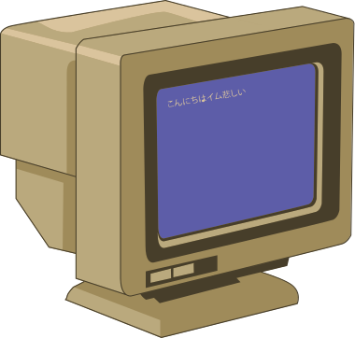

studio shodwe
VACUUM TUBES
The emergence of vacuum tubes in the mid-20th century marked a significant leap forward in computing technology. These glass-encased electronic components functioned as amplifiers and switches, enabling the manipulation of electrical signals in early computers. Despite their size and propensity for overheating, vacuum tubes formed the basis of the first generation of electronic computers, such as the ENIAC (Electronic Numerical Integrator and Computer). The utilization of vacuum tubes in computing systems represented a paradigm shift, allowing for faster and more reliable electronic computation than previously thought possible.

Slide 4

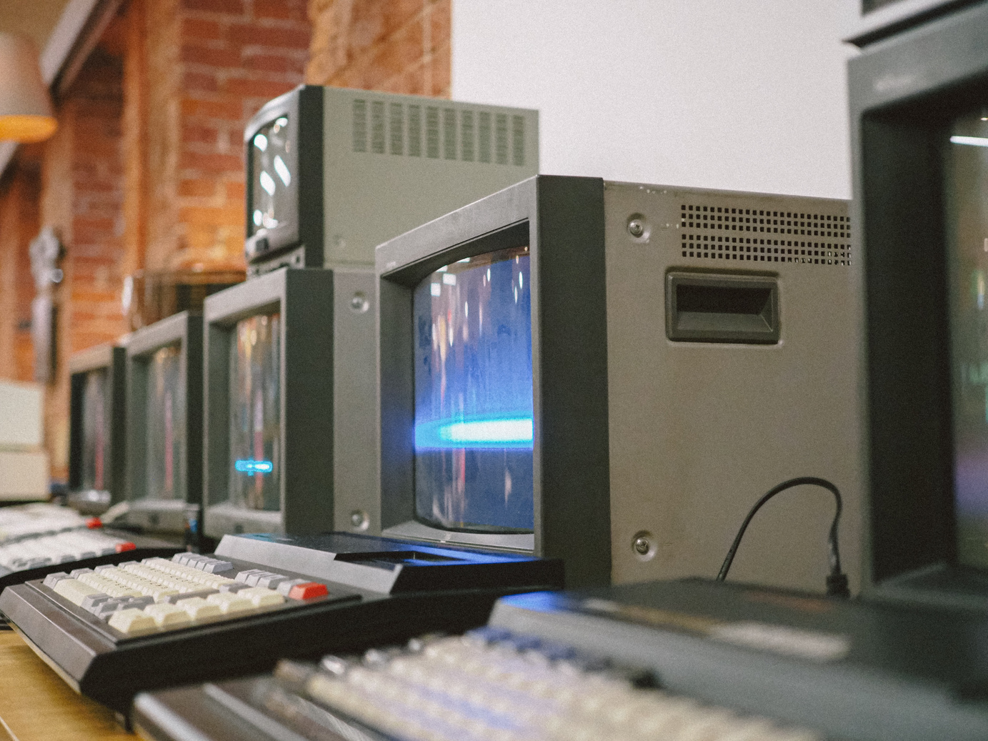
studio shodwe
TRANSISTOR REVOLUTION
The invention of transistors in 1947 sparked a revolution in electronics, replacing bulky vacuum tubes with compact, reliable semiconductor devices. Transistors paved the way for smaller, faster, and more efficient computers.

Slide 5


studio shodwe
INTEGRATED CIRCUITS
Integrated circuits emerged in the late 1950s, integrating multiple transistors onto a single chip. These circuits dramatically reduced the size and cost of computers while increasing their processing power, ushering in the semiconductor era.

Slide 6


studio shodwe
PERSONAL COMPUTERS
The 1970s saw the rise of personal computers, bringing computing power to individuals. PCs from companies like Apple and IBM democratized technology, transforming how people work, communicate, and access information.

Slide 7
studio shodwe
GRAPHICAL USER INTERFACE
The emergence of vacuum tubes in the mid-20th century marked a significant leap forward in computing technology. These glass-encased electronic components functioned as amplifiers and switches, enabling the manipulation of electrical signals in early computers. Despite their size and propensity for overheating, vacuum tubes formed the basis of the first generation of electronic computers, such as the ENIAC (Electronic Numerical Integrator and Computer). The utilization of vacuum tubes in computing systems represented a paradigm shift, allowing for faster and more reliable electronic computation than previously thought possible.

Slide 8

studio shodwe
GLOBAL CONNECTIVITY
The internet connected billions of devices and users worldwide, transcending geographical boundaries and enabling seamless communication and collaboration.
INTERNET AGE
DEMOCRATIZATION OF INFORMATION
Web browsers and protocols democratized access to information, empowering individuals with unprecedented access to knowledge and resources.
E-COMMERCE REVOLUTION
The internet facilitated the rise of e-commerce, revolutionizing the way businesses operate and consumers shop, leading to the emergence of global online marketplaces and digital storefronts.

Slide 9


studio shodwe
MOBILE COMPUTING
In the 21st century, smartphones and tablets revolutionized computing, enabling on-the-go access to communication, productivity, and entertainment. Mobile devices transformed how we interact with technology.

Slide 10
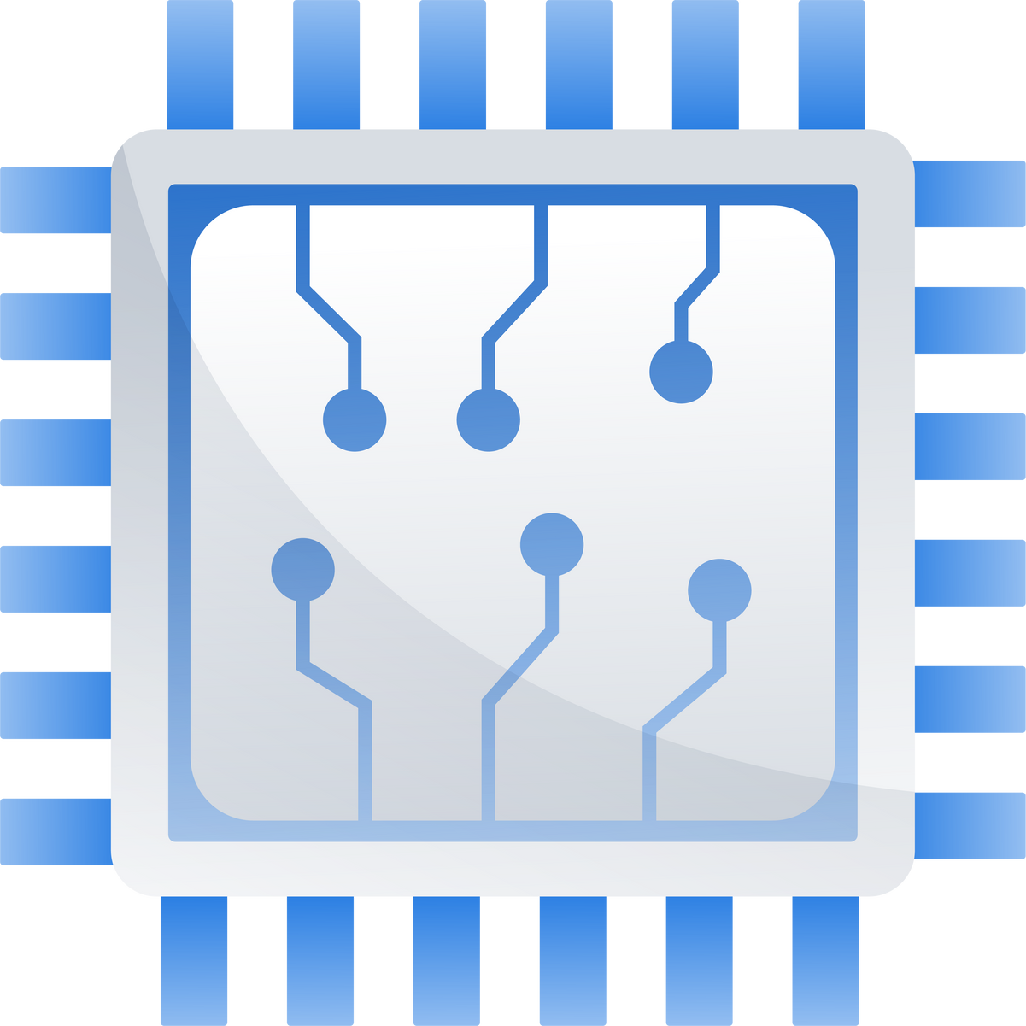
studio shodwe
ARTIFICIAL INTELLIGENCE
Recent advances in artificial intelligence have led to machines that can perceive, learn, and reason like humans. AI technologies are revolutionizing industries and reshaping society, driving innovation across domains.

Slide 11
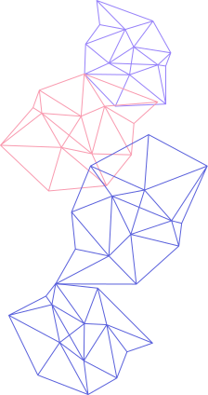


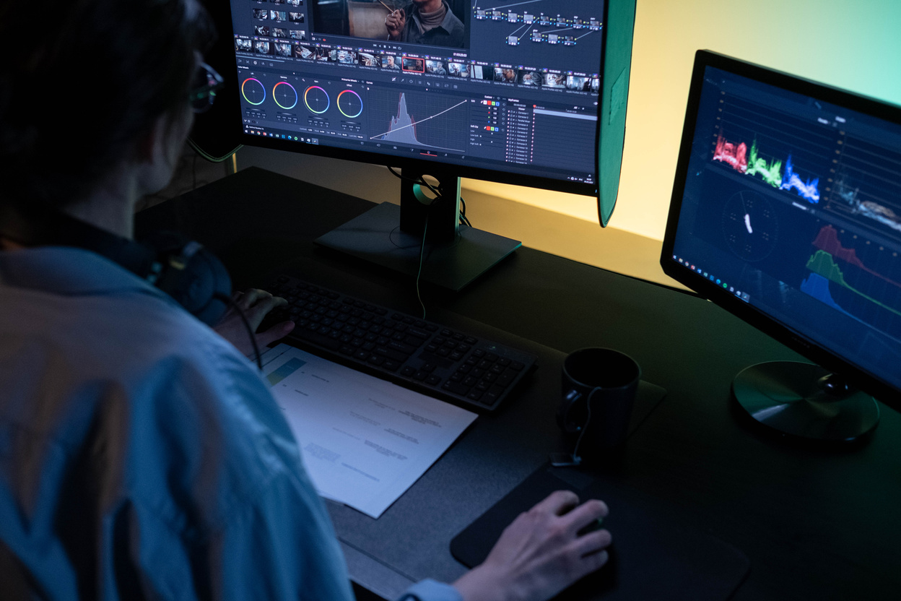
studio shodwe
QUANTUM COMPUTING
Quantum computing, leveraging quantum mechanics principles, promises exponentially faster computation speeds. While still in its infancy, quantum computing holds the potential to tackle complex problems across various fields.

Slide 12
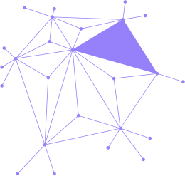


studio shodwe
The 1970s saw the rise of personal computers, bringing computing power to individuals. PCs from companies like Apple and IBM democratized technology, transforming how people work, communicate, and access information.
CYBERSECURITY CHALLENGES

Slide 13

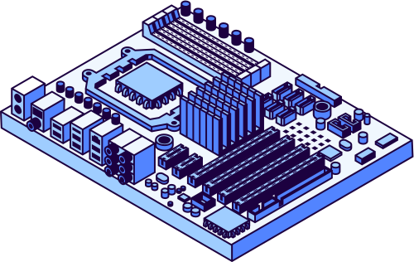
studio shodwe
ETHICAL CONSIDERATIONS
The widespread adoption of computers raises important ethical considerations, such as data privacy, algorithmic bias, and the impact of automation on jobs. Balancing technological advancement with ethical principles is essential for creating a more equitable and inclusive society.

Slide 14

studio shodwe
FUTURE PROSPECTS
Looking ahead, the future of computing holds limitless possibilities, with advancements in areas like quantum computing, artificial intelligence, and biocomputing shaping our world. Embracing innovation while addressing challenges will define the trajectory of computing in the years to come.

Slide 15



THANK
+123-456-7890
Thank you for joining us on this journey through the evolution of computers. For further inquiries or collaborations, please feel free to contact us.
www.reallygreatsite.com
YOU!
hello@reallygreatsite

